Slide 1

Microsoft Film Research Project

Slide 2
Outline
Business Problem
Data Used
Findings
Recommendations
Conclusion

Slide 3
Business Problem
Microsoft sees all the big companies creating original video content and they want to get in on the fun. They have decided to create a new movie studio, but they don’t know anything about creating movies.
You are charged with exploring what types of films are currently doing the best at the box office. You must then translate those findings into actionable insights that the head of Microsoft’s new movie studio can use to help decide what type of films to create.

Slide 4
Data Used
In the course of my analysis, the following data was useful:
* imdb.title.basics
* imdb.title.ratings
* bom.movie_gross
* tmdb.movies.csv

Slide 5
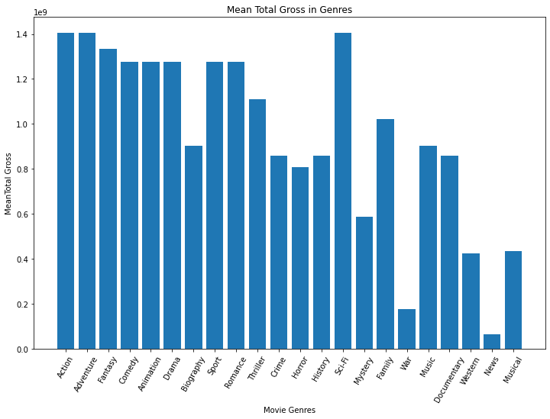
Findings 1.Action, Adventure, Sci-Fi, and Fantasy genres have generated the highest total gross figures.

Slide 6
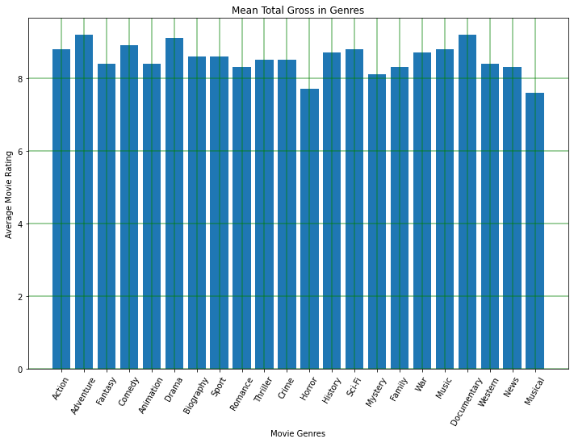
2. The Adventure, Drama, and Documentary genres were the top three based on their ratings.

Slide 7
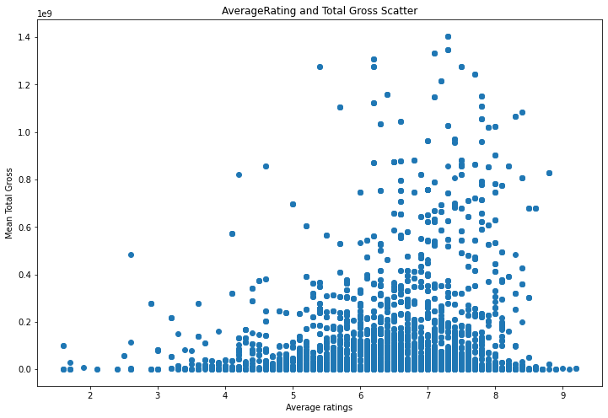
3. The data suggests a slight positive relationship between average ratings and mean total gross.

Slide 8
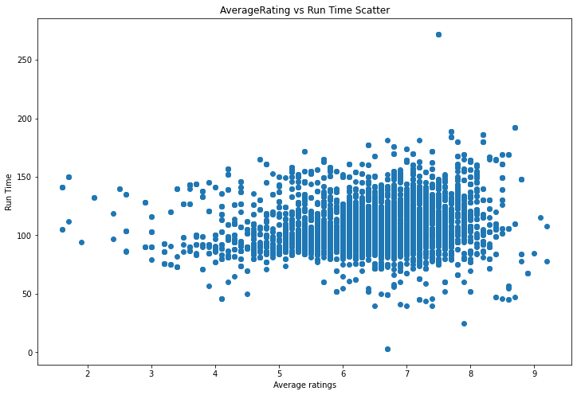
4. The analysis shows that there is minimal relationship between the runtime of a movie and its average ratings

Slide 9
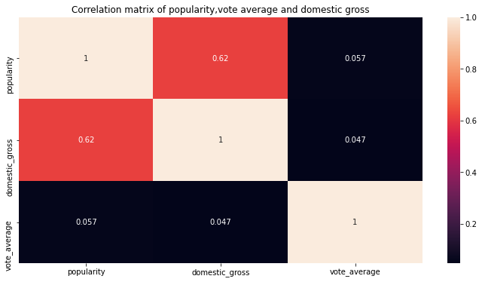
5. The analysis indicates that there is a strong positive effect of a studio's popularity on its domestic gross

Slide 10
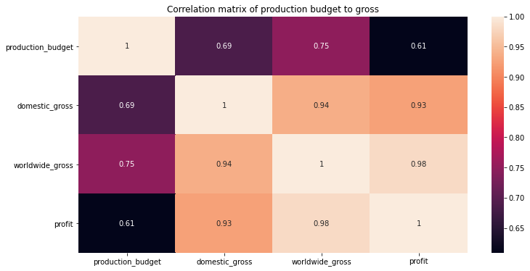
6. The data analysis suggests that the production budget has a relatively significant impact on both domestic and worldwide gross, as well as overall profits

Slide 11
Recommendations
Genre Selection for Maximum Revenue: As Action, Adventure, Sci-Fi, and Fantasy genres have demonstrated the highest total gross figures
Balance of popularity and Financial Success: The Adventure, Drama, and Documentary genres are top-rated based on critical acclaim
Invest in Quality Productions: The slight positive correlation between average ratings and mean total gross suggests that well-received movies can have a positive impact on overall revenue.

Slide 12
Recommendations cont..
Efficient Runtime Management: As there is minimal relationship between runtime and average ratings, focus on storytelling and pacing rather than being worried about specific runtime
Learn the practices of top performing Competing Companies: Given the strong positive effect of studio popularity on domestic gross
Optimal Budget Allocation: Recognize the impact of production budgets on domestic and worldwide gross as well as overall profits. Carefully assess budget decisions, considering the genres, target audience and projected potential to achieve a balance between investments and returns.

Slide 13
Conclusion
By considering the above recommendations, Microsoft is now better placed to face the challenge. The identified factors, such as genre selection, production quality, and audience-centered strategies and Budget allocation will play crucial roles in determining success of Microsoft's film studio.

